Slide 1
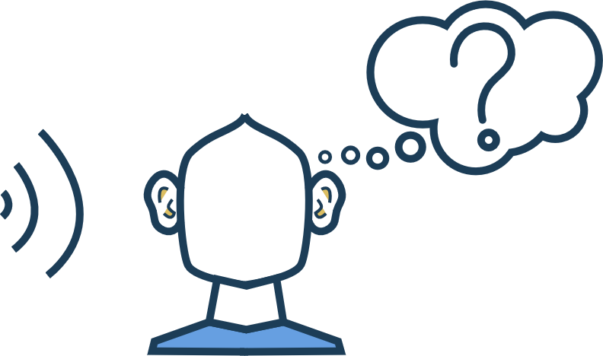
Chapter 8
Sound and Meaning

Slide 2
OVERVIEW
Classical Conditioning
Sonic Archetypes
Semiotic Theory
Phenomenology & Embodied Cognition

Slide 3
Classical Conditioning
Pavlov’s Dog: 1890s
Stimulus: stimulates senses
  Induces a Response
Conditioned: learned response
Neutral stimulus:
doesn’t in itself
produce response
until learned

Slide 5

Conditioning: Reward sounds

Slide 6
Operant conditioning (BF Skinner, 1938)
https://schoolworkhelper.net/b-f-skinner-operant-conditioning-skinner-box-baby-tender/

Slide 7
Operant conditioning: reinforcement
Behaviours have consequences : neutral operants, reinforcers and punishers
Positive Reinforcement : gives rewards e.g. in a game
Negative Reinforcement : reward is take away something bad (e.g. seatbelt sound).

Slide 8
Operant conditioning : punishment
Positive Punishment : attempts to add something bad to decrease behaviour -> slam door in argument
Negative Punishment : take away something good to decrease behavior -> e.g remove sound from slot machine

Slide 9
Universal vs. Conventional Sounds

Slide 10
Anamnesis

Slide 11


Basic Semiotic Theory: Signs
SIGN = anything that has meaning other than itself
This sign (a road sign) carries the meaning “no horns”.
This sign (the M) carries the meaning ”McDonald’s”.
This sign (smoke) carries the meaning “something is burning”.
“CAT”
This sign (the word cat) carries the meaning ”cat”.

Slide 12

Semiotic Theory: How many signs??

Slide 13
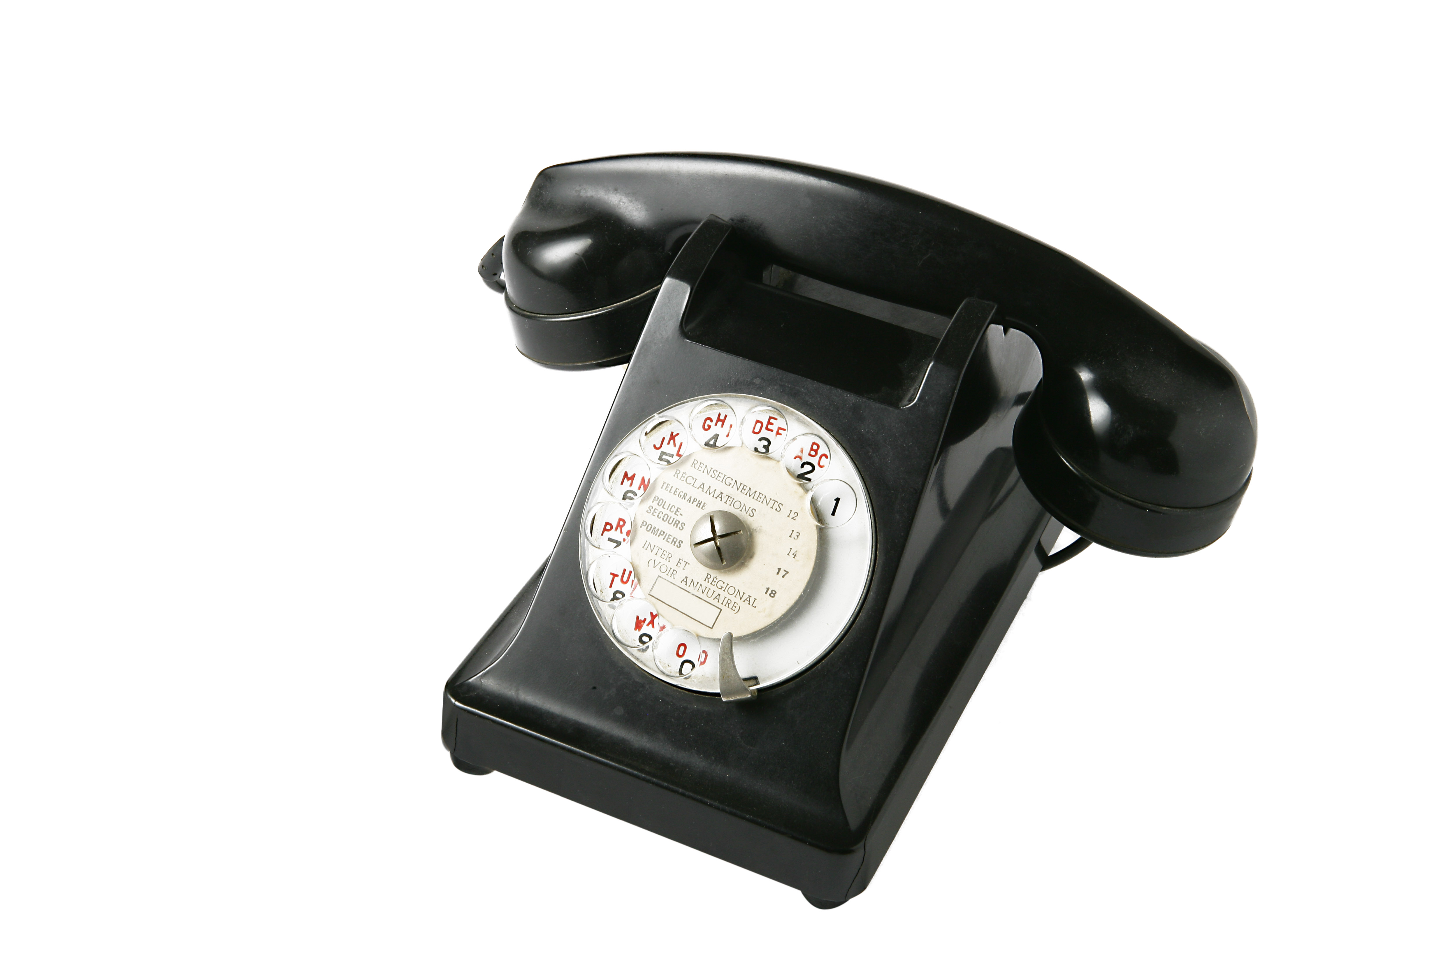
Basic Semiotic Theory: Signifier & signified
Signifier: phone ringing
Signified: someone is calling us (happy? anxiety?)
Denotation: literal meaning: someone is calling us
Connotation: associations: happy, anxiety, etc.

Slide 14
Signifier and Signified, Connotation & Denotation
What is the signifier and signified?
What is the connotation and denotation(s)?

Slide 15

Failures of Communication
Socio-Cultural references
Understand symbol
Have same interpretation

Slide 16
Semiotic Analysis: inter-objective comparison
Compare sound(s) across examples from media

Slide 17
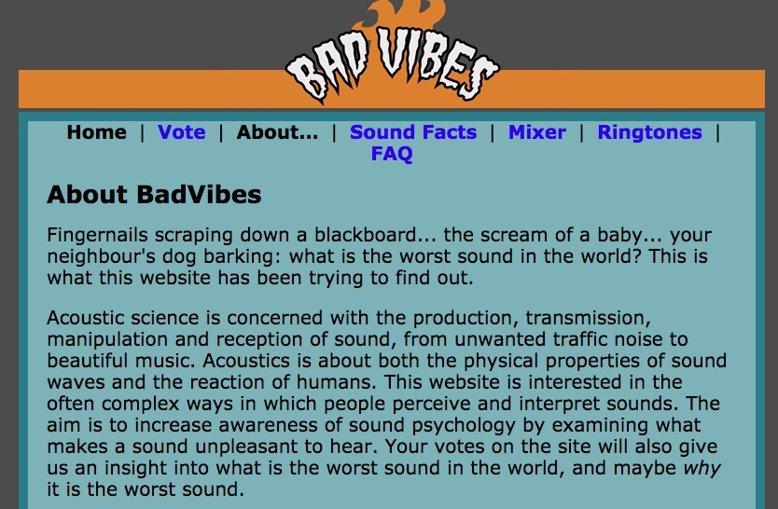
Semiotic Analysis: inter-subjective comparison
Compare responses across users

Slide 18
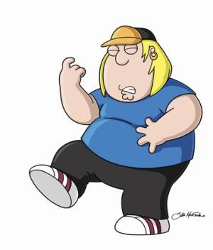
Phenomenology
“Family Guy” air guitar

Slide 19
Embodied Cognition
"Corporeal Signification”
“Anthropomorphic Projection”
Mark Leman, “Embodied Music Cognition” (2007)
Joel Chadabe, “Electronic Music and Life” (2004)
“Kinesthetic Sympathy”
John Cage (1961)
“Mimetic Hypothesis”
Arnie Cox, “Embodying Music” (2011)
Icons: https://thenounproject.com/
Notes:
We understand human-made sounds (including those of playing a musical instrument) in terms of our own experience of making similar sounds and movements. That mental re-creation of the sound causes a neuronal and motor-sensory response that mimics the performer's actions, and then we are able to interpret the emotional inflections through a mental re-creation of that action.
Again, the ideas and theory were around before the actual neurobiological understanding of these processes—in music, it’s been called the mimetic hypothesis, kinesthetic sympathy, anthropomorphic projection and corporeal signification, among others.

Slide 20
MIRROR NEURON THEORY
AUDITORY
AFFECTIVE SYSTEMS
VISUAL
*after Paula M. Niedenthal, “Embodying Emotion” 2007
Icons from thenounproject.com
Notes:
In the past fifteen years or so, scientists have discovered that when we’ve experienced something, that experience fires off neurons in our brain, so if we encounter a grizzly bear, a bunch of neurons are going to fire in our brain. If, later on, we just see a movie of a bear, or hear that roar, almost all the same neurons fire. In other words, when we get a similar stimulus, our brain pretty much responds as if it’s happening to us, for real, again.
This works so well, that if we see something happening to somebody else, we still experience it in our brain to some extent as if it’s happening to us… so if you see someone else getting pricked by a needle, many of your neurons fire as if you are being pricked by a needle, which is why they’re called mirror neurons—we mirror the experiences of others. Some people have called them Gandhi neurons, because it’s been proposed that they are the foundation of empathy.
Essentially what this means is that visuals and audio are capable of evoking responses in our bodies and minds based on our past experiences, and as sound designers we can draw on that knowledge to guide a person towards a particular feeling or association.

Slide 21
INTERSENSORY INTEGRATION
Istockphoto
Notes:
The idea of intersensory integration with sounds can be best illustrated like this, and I need some audience participation for this bit: I’m going to ask you to raise your hands to answer if you would imagine lemons making sound: would lemons make a low frequency (bass), mid-frequency (my voice range), or high frequency sound.
?
How is it we all agree on the sound lemons make?
Now I’d like you to imagine yourself making that sound--if you’d like to make the sound out loud that’s fine, but you can do it in your head too: close your eyes and sonify these lemons for me.
So, shoulders go up, eyes get pinched, lips draw back—we feel the sound in our body—the piercing high frequency is similar to what our body does when we taste very sour food like lemons. it's this! ()
This demonstrates how sound and taste can be integrated in our minds, and those types of interactions occur between other senses as well.

Slide 22
Sound + Image: Bouba & Kiki

