Slide 1
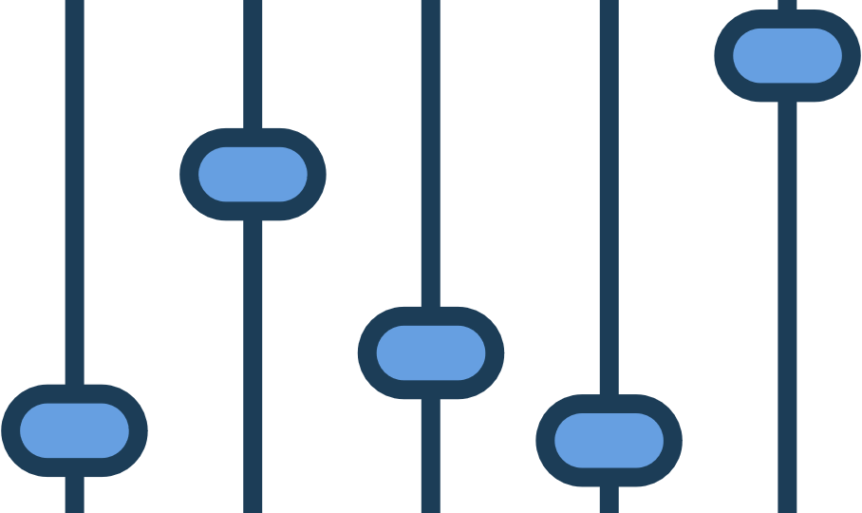
Chapter six
Mixing

Slide 2
OUTLINE
Dynamic Range
Compression, Limiting & Normalization
Expansion
Gating and Ducking
Noise Reduction
Mixing theories
Figure and Ground/ Signal to Noise
Panning
Point of Audition

Slide 3
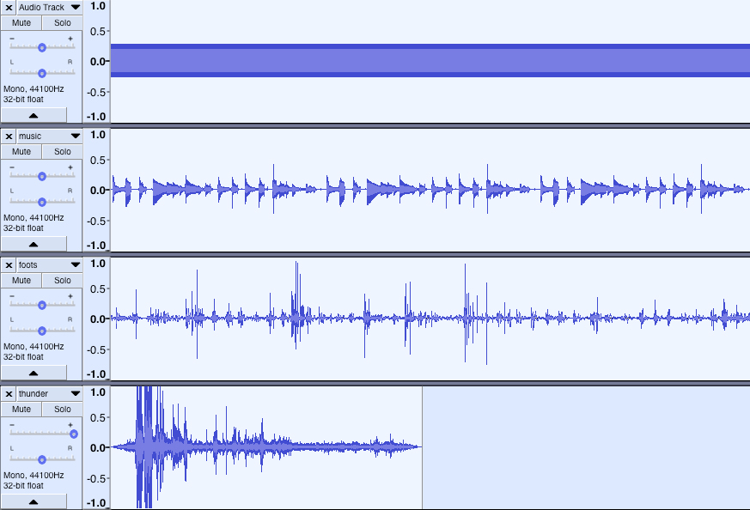
Dynamic Range
Which has the MOST and LEAST dynamic range?

Slide 4
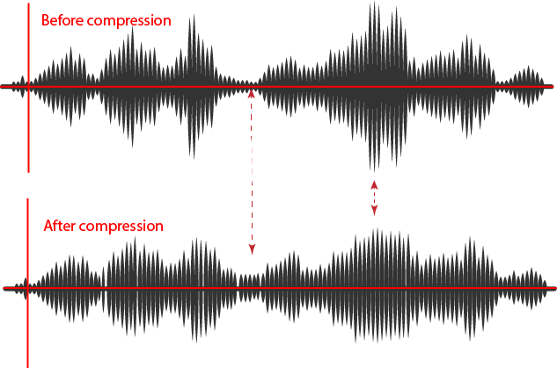
Compression
Reduces dynamic
range over whole file
(“squashes”) by
Cutting High and
boosting Low

Slide 5
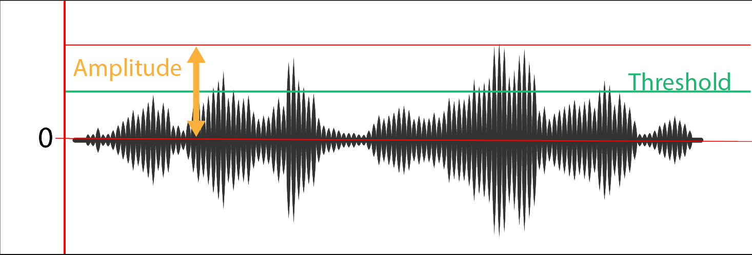
Compression Threshold
How loud signal is before compression is applied

Slide 6
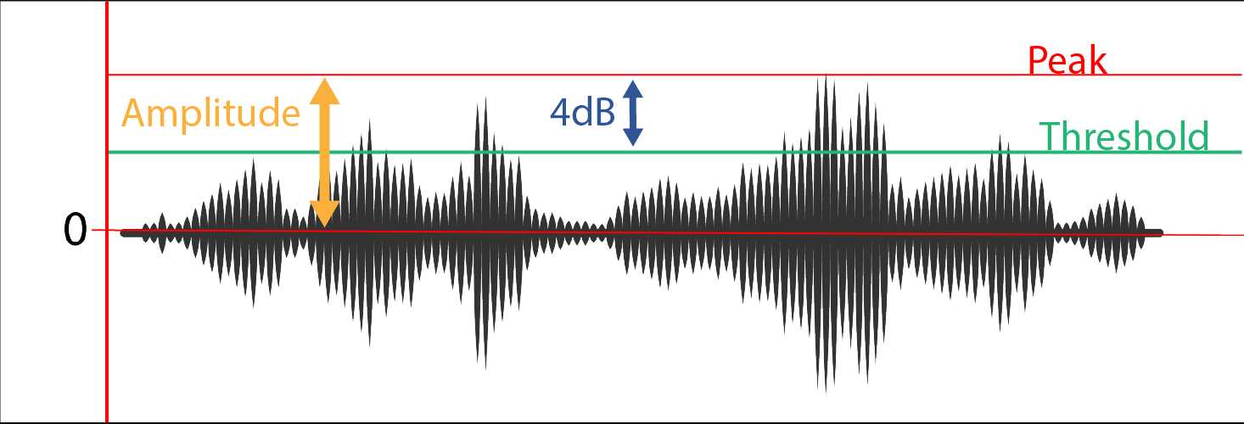
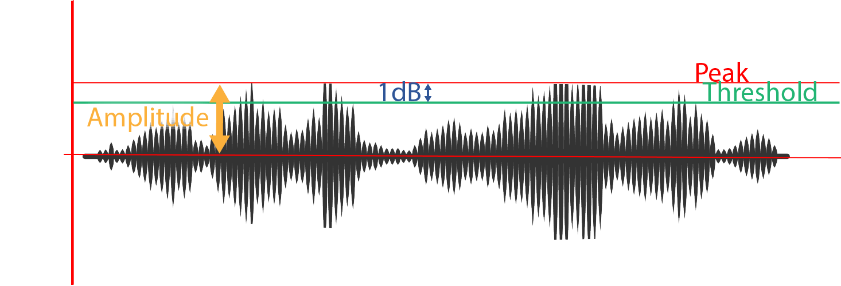
Compression ratio
Change in output levels above the threshold
4:1 ratio: 3dB reduction above threshold (For every 4dB, reduce to 1dB)

Slide 7
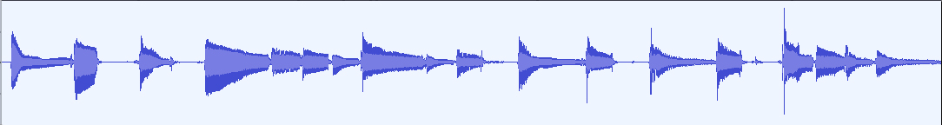
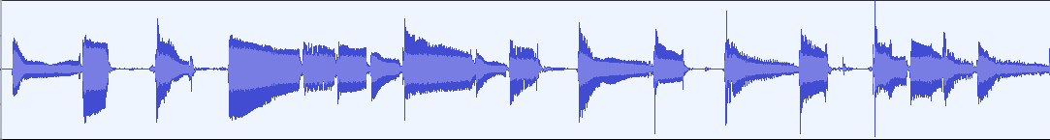
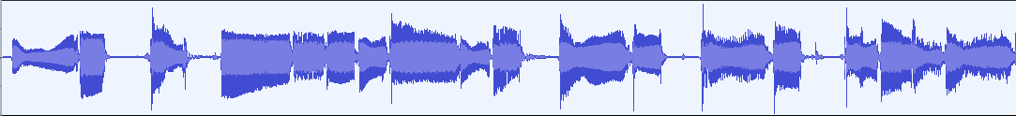
Examples: Compression Ratio
Raw file
2: 1 ratio
7:1 ratio

Slide 8
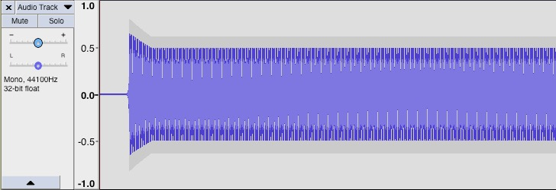
Compression: Attack Time
How quickly amplitude is reduced once input exceeds threshold
Attack time
threshold
Compression begins

Slide 9
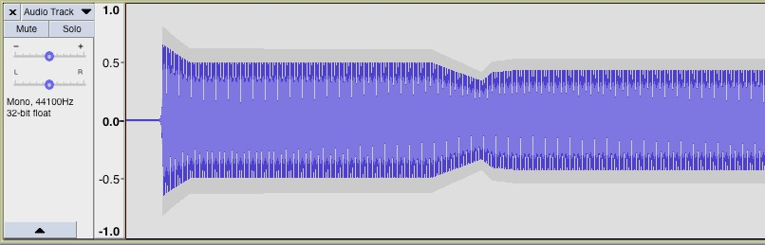
Compression: Release Time
How quickly compressor releases after sound wave drops below threshold
Release time

Slide 10
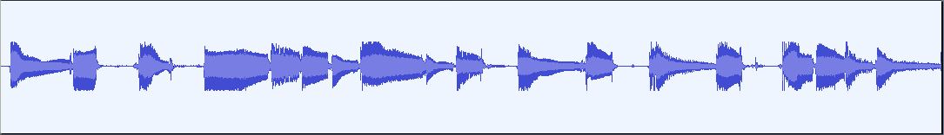



Limiting
Compression ratio > 10:1
Raw file
Limiting to -10dB

Slide 11
Compression Tips
Don’t over-compress. Some dynamic range is good! (keep ratio under 5:1)
Settings in this effect work together. Adjust them together and see how they affect the output.
Takes a lot of practice—listen carefully
It will increase background noise
Some fast attacks can cause low frequencies to distort

Slide 12
Why compress?
Makes overall average sound louder → advertising on TV
Prevents audience from “riding the remote”
Evens out vocal recordings
“pumping” percussion e.g. drums -> heavily used in dance music

Slide 13
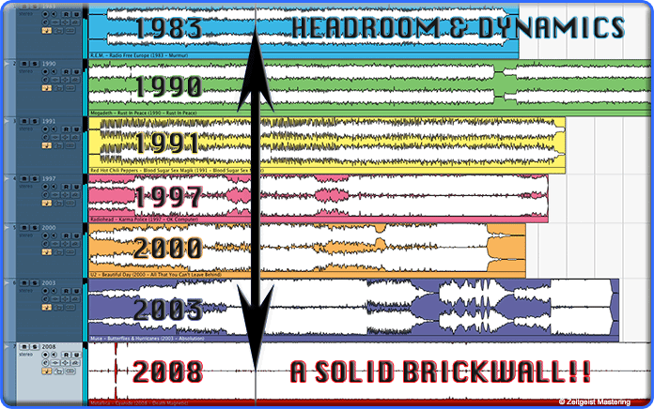
The Loudness Wars
Zeitgeistmastering.com

Slide 14
“Loudness war” explanation video
https://www.youtube.com/watch?v=3Gmex_4hreQ

Slide 15
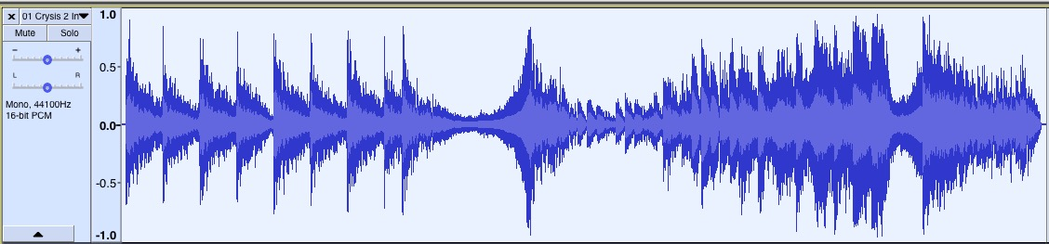
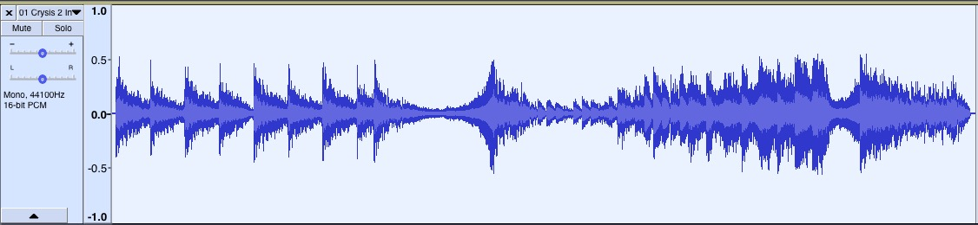
Normalization
Sets loudest peak of file to that level & adjusts rest to match
Maintains dynamic range, adjusts overall level.
Original file
Normalized to -5 dB

Slide 16
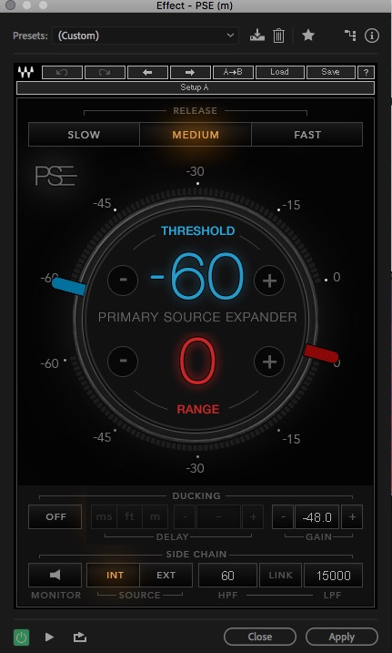
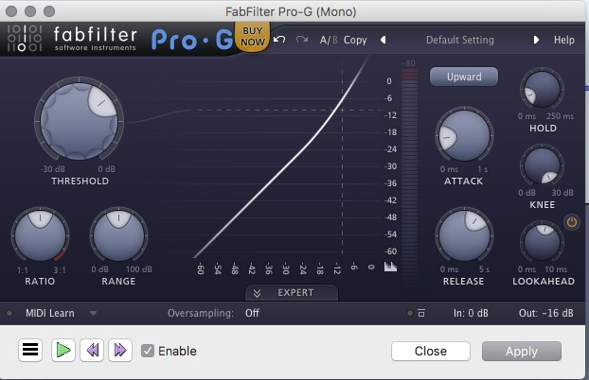

Expander (*no expander in Audacity)
Waves
PSE
FabFilter Pro-G expander

Slide 17
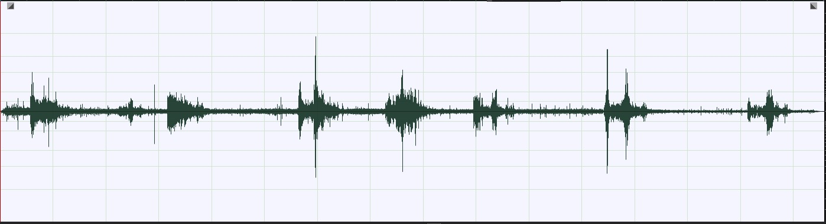
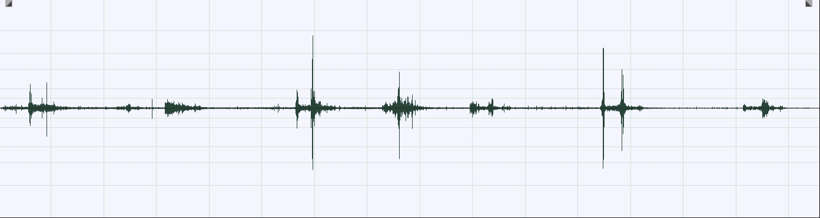
Expansion
Opposite of compression: expands dynamic range by reducing sounds below threshold
Threshold: -12 dB

Slide 18
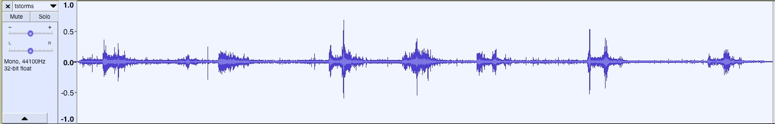
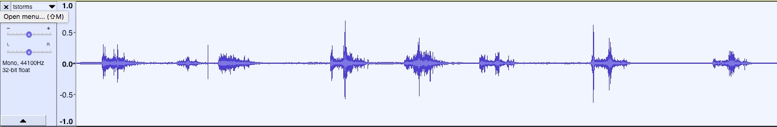
Gating = Harsh Expander
Gate at -12dB threshold

Slide 19
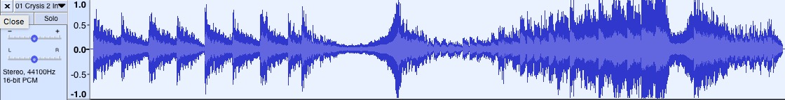
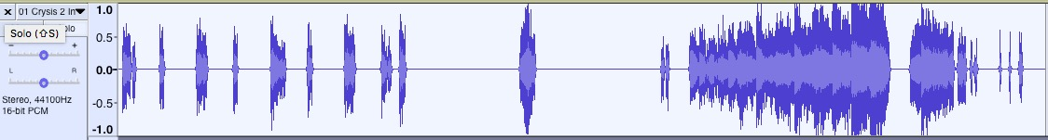
Hard gate to -6dB

Slide 20
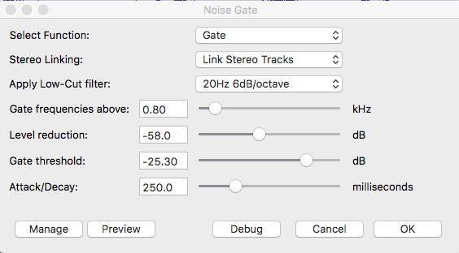
Noise Gate in Audacity

Slide 21
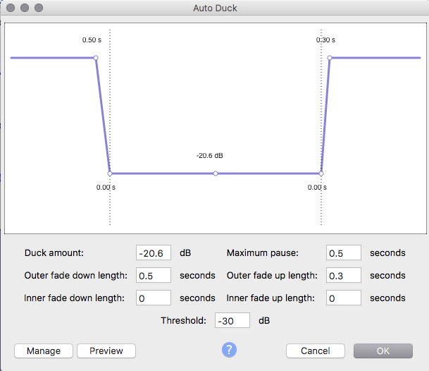
Ducking
Reduces signals above a threshold by range by using second control file to set where ducking takes place
Common use in radio to duck music under voice

Slide 22
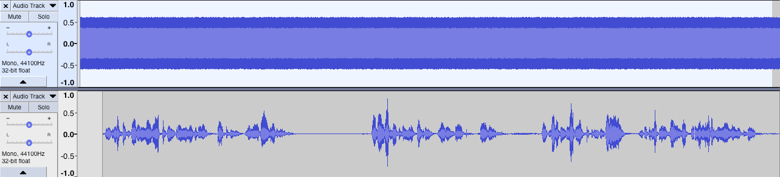
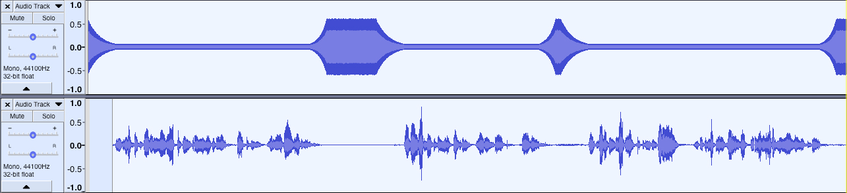
Ducking
File to duck
Control file
Result--ducked
Control file

Slide 23
Side-Chaining
Using a control file to feed into an effect to alter the effect’s amount
Mostly used on compression-related effects

Slide 24
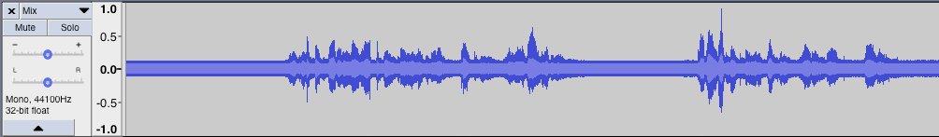
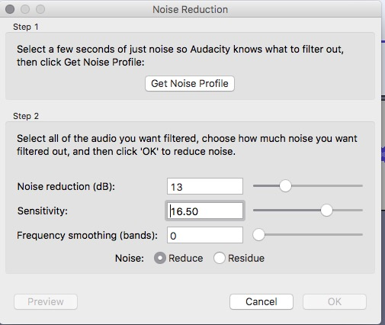
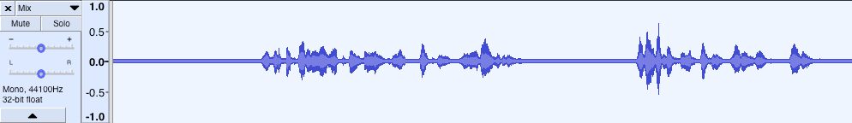

Noise Reduction
Control = “Noise profile”
Noise profile: sample of noise you want to eliminate

Slide 25
Mixing Theories

Slide 26
3 dimensions of mixing

Slide 27
Near vs. Far
Louder
More EQ in mid to high frequency
Less reverb/delay
Hard compression
Unusual effects → stick out

Slide 28
High and Low
EQ: high frequencies up high, low frequencies down low
Resonators in our body: head = high, gut = low

Slide 29
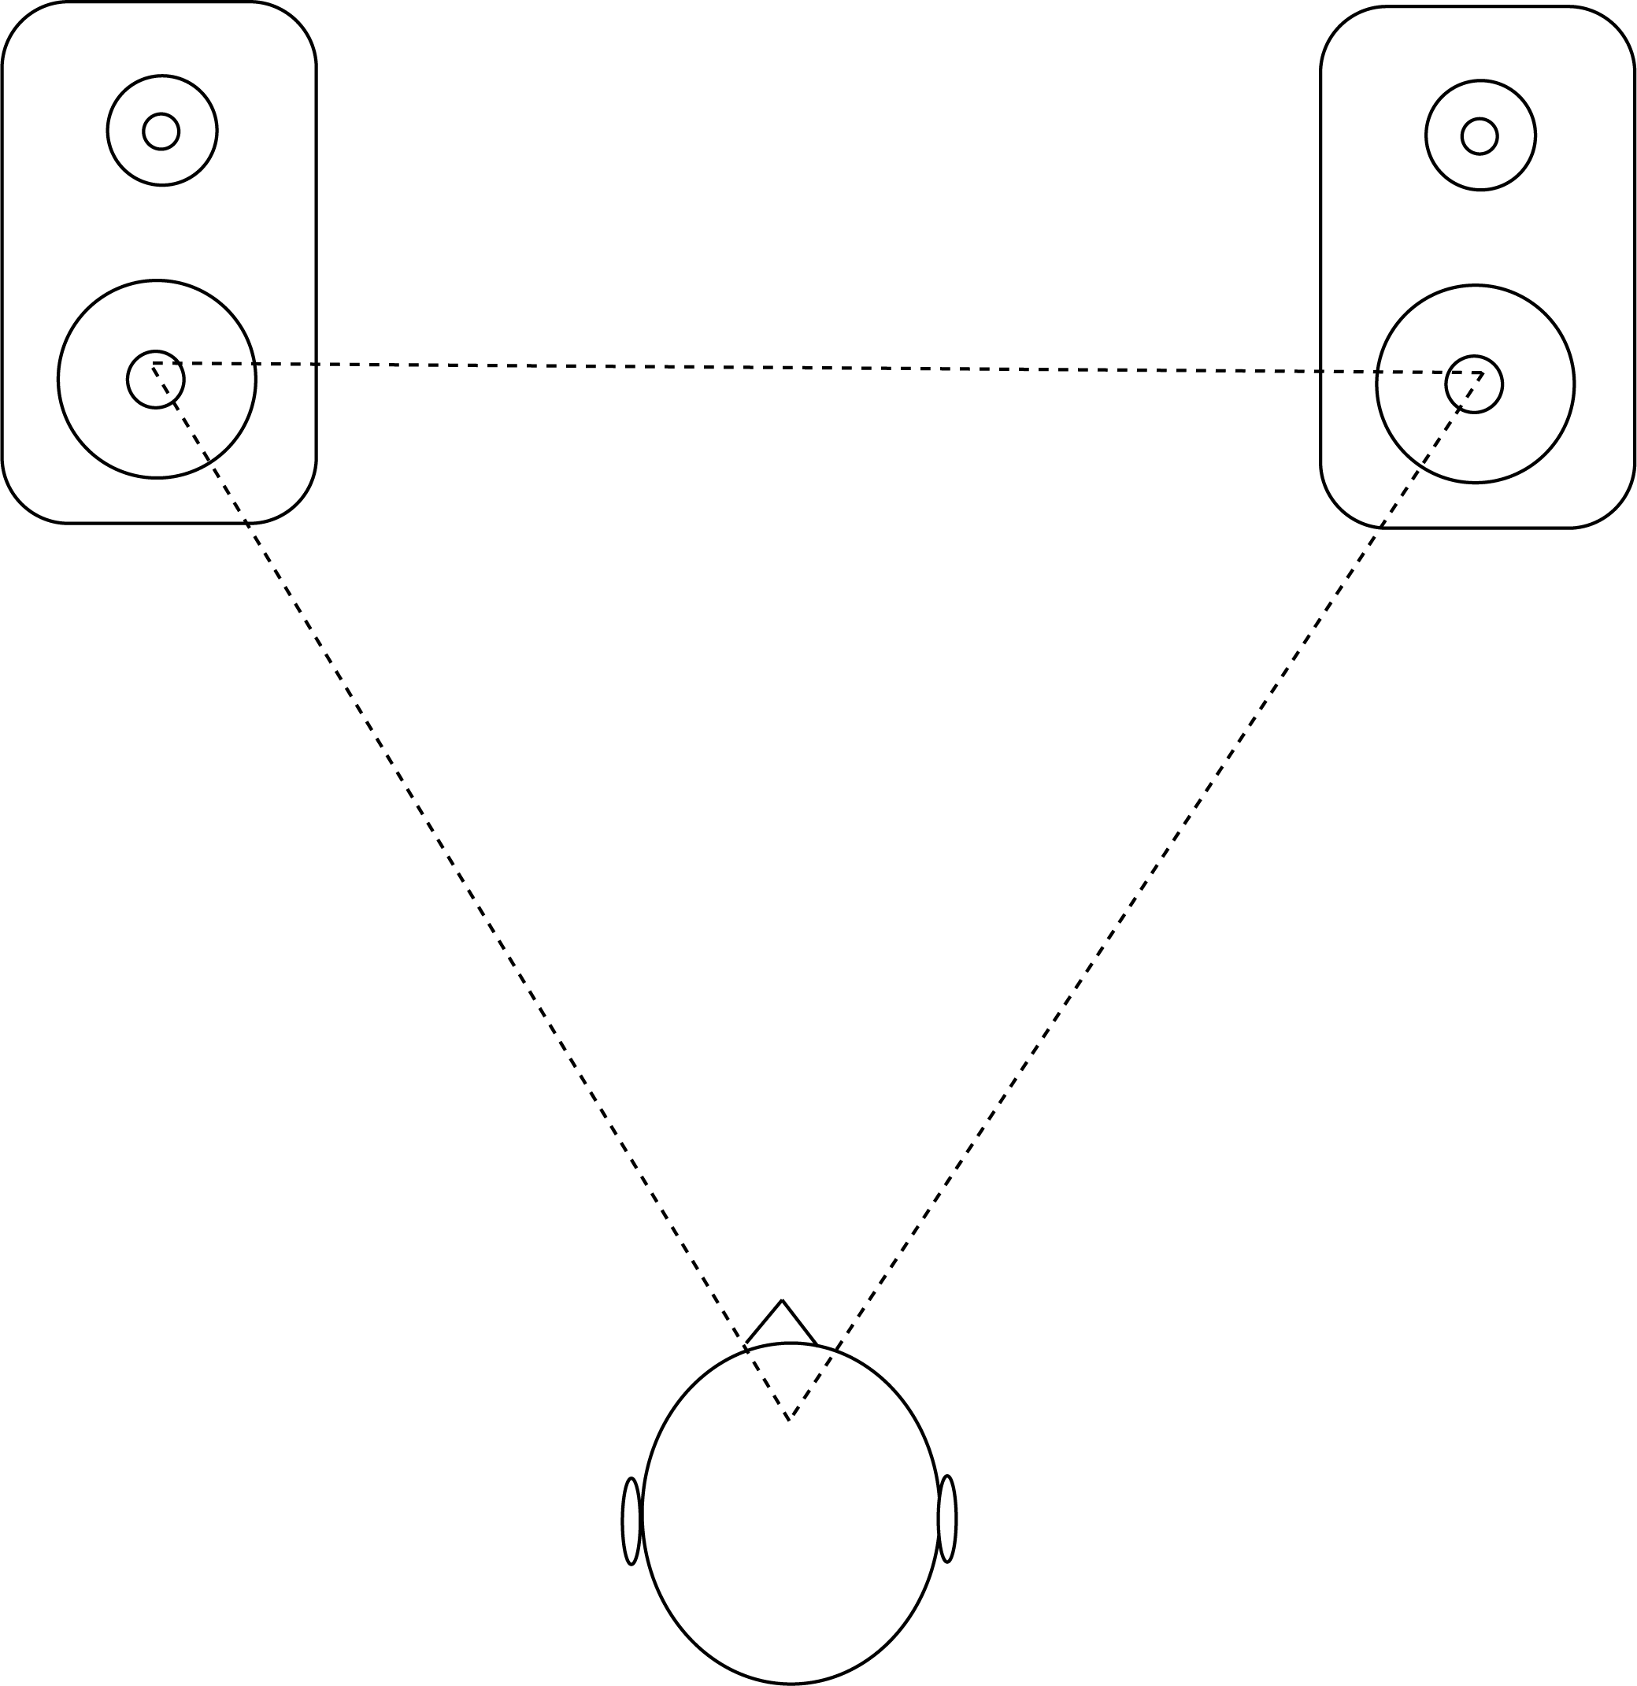
Left to right : Panning
Stereo positioning:
Sweet spot is at
corner of equilateral
triangle (when using
loudspeakers!)
60º
Sweet spot

Slide 30
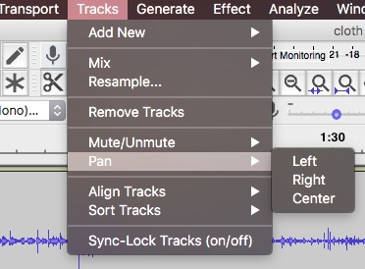
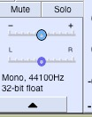

Panning in Audacity

Slide 31
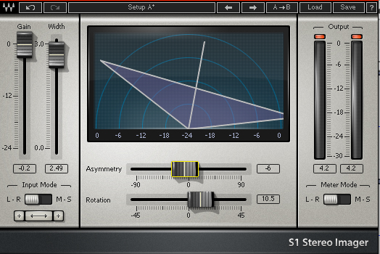
Advanced stereo panning: Waves S1 ($)

Slide 32
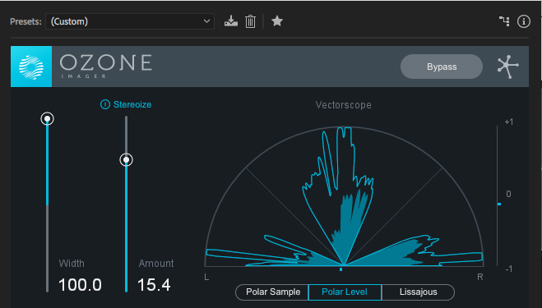
Advanced Stereo Imaging: Ozone Imager

Slide 33
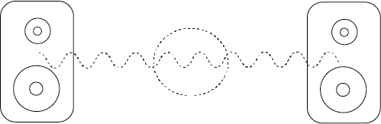
Phantom Images

Slide 34
Figure and Ground
Foreground
Midground
Background
Photo: Earl Noble, http://vocm.com/news/rnc-urges-caution-near-emergency-scenes/

Slide 35
Masking : NOISE
White noise = broad frequency spectrum, evenly across entire frequency
Pink noise = white noise with high frequencies attenuated
Brown noise = exaggerated pink noise (even more attenuation)

Slide 36
Point of Audition
Where is the audience?
Analogous to POV in film– position as “in” a scene or outside a scene.

Slide 37
Point of Audition
Emphasis in mix through EQ, panning and volume
Use of filters
Use of effects
Microphone selection
Microphone location
Channel/speaker location
Spatial location of sounds

Slide 38
Creative versus technical mix
Psychological state of character
Altered physical state of character
Focus audience’s attention

